Slide 1


Programming One (csc7050)
Aidan McGowan
Abstraction

Slide 2
Abstraction definition
Abstraction refers to the ability to make a class abstract in OOP.
An abstract class is one that cannot be instantiated.
All other functionality of the class still exists, and its fields, methods, and constructors are all accessed in the same manner.
You just cannot create an instance of the abstract class.

Slide 3
Cannot create one of these ?
If a class is abstract and cannot be instantiated, the class does not have much use unless it is subclassed.
This is typically how abstract classes come about during the design phase.
A parent class contains the common functionality of a collection of child classes, but the parent class itself is too abstract to be used on its own.

Slide 4
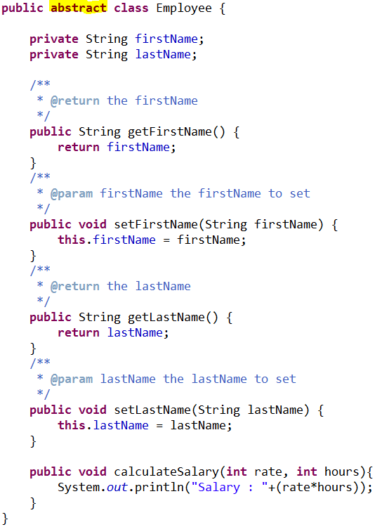
Abstract Class
Use the abstract keyword to declare a class abstract.
The keyword appears in the class declaration somewhere before the class keyword.

Slide 5
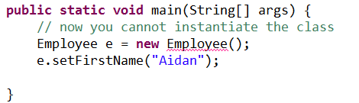
Can’t compile !
Now if you try as follows :
Then try to compile above class. Would result is the following error:

Slide 6
Extending Abstract Class
Extend Employee class :
Employee
- firstName : String - lastName : String
+ calculateSalary()
Use of italicised text for the Employee class name indicates that the Employee class is an abstract class
Lecturer
- school
+ calculateSalary()
Reader
- research: String

Slide 7
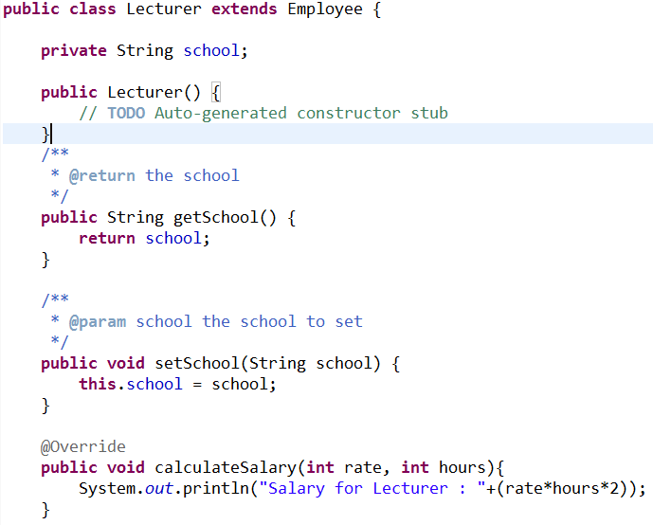
Lecturer class
extends the (abstract) Employee class and overrides the calculateSalary method

Slide 8
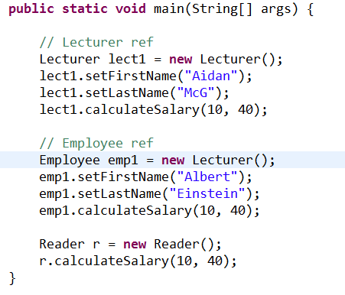

Would result in ….

Slide 9
Abstract Methods
If you want a class to contain a particular method but you want the actual implementation of that method to be determined by child classes, you can declare the method in the parent class as abstract.
The abstract keyword is also used to declare a method as abstract. An abstract method consists of a method signature, but no method body.

Slide 10
Declare abstract method
Abstract method would have no definition, and its signature is followed by a semicolon, not curly braces as follows:

Slide 11
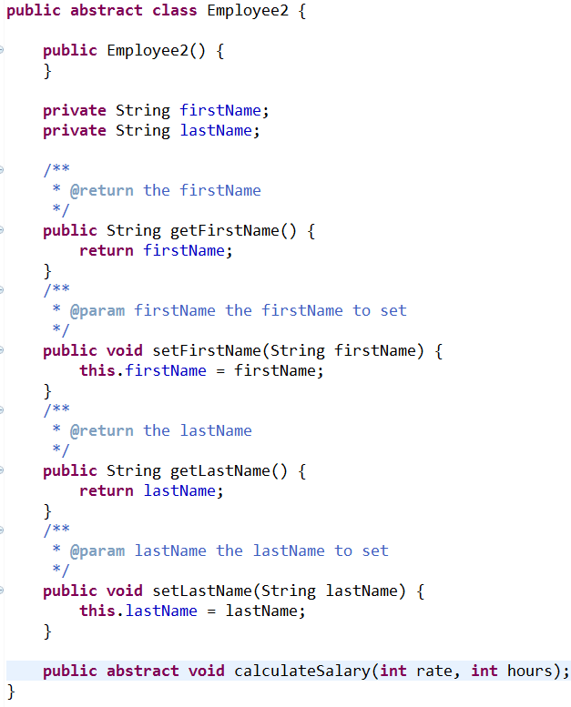
Abstract method
Declaring a method as abstract has two results:
The class must also be declared abstract.
Any child class must either override the abstract method or declare itself abstract.
A child class that inherits an abstract method must override it. If they do not, they must be abstract and any of their children must override it.
Eventually, a descendant class has to implement the abstract method; otherwise, you would have a hierarchy of abstract classes that cannot be instantiated.

Slide 12
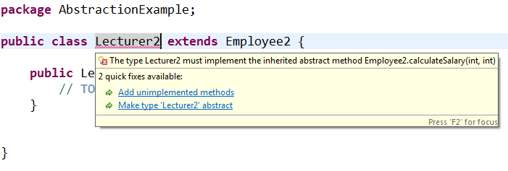
Must override and implement

Slide 13
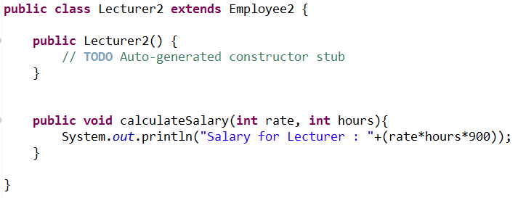
Implemented in child class

Slide 14
Abstraction exercise
Create the following and test…
eBook
- title : String
+ readBook()
Note eBook and method readBook are abstract.
Only books that have been downloaded from Amazon can be read on the Kindle. The Nexus reads anything ! If Ok to read then the readBook() method should output “Reading book…”
KindleBook
- downloadedFromAmazon : boolean
+ readBook()
NexusBook
+ readBook()
Notes:
package AbstractionExample;
public abstract class eBook {
private String title;
public eBook(){
}
public eBook(String title){
this.setTitle(title);
}
/**
* @return the title
*/
public String getTitle() {
return title;
}
/**
* @param title the title to set
*/
public void setTitle(String title) {
this.title = title;
}
public abstract void readBook();
}
_____________________________________________________________________________________________________________
package AbstractionExample;
public class KindleBook extends eBook {
public boolean downloadedFromAmazon;
public KindleBook() {
this.downloadedFromAmazon = false;
}
public KindleBook(String title, boolean downloadedFromAmazon) {
super(title);
this.downloadedFromAmazon = downloadedFromAmazon;
}
/**
* @return the downloadedFromAmazon
*/
public boolean isDownloadedFromAmazon() {
return downloadedFromAmazon;
}
/**
* @param downloadedFromAmazon the downloadedFromAmazon to set
*/
public void setDownloadedFromAmazon(boolean downloadedFromAmazon) {
this.downloadedFromAmazon = downloadedFromAmazon;
}
@Override
public void readBook() {
if (this.downloadedFromAmazon){
System.out.println("OK to read book");
} else {
System.out.println("Not downloaded from Amazon. Cannot read.");
}
}
}
_______________________________________________________________________________________________________________
package AbstractionExample;
public class NexusBook extends eBook {
public NexusBook() {
// TODO Auto-generated constructor stub
}
public NexusBook(String title) {
super(title);
}
@Override
public void readBook() {
System.out.println("No issues. Enjoy the read...");
}
}
_______________________________________________________________________________________________________________________
package AbstractionExample;
public class eBookReader {
public eBookReader() {
// TODO Auto-generated constructor stub
}
public static void main(String[] args) {
KindleBook kb = new KindleBook();
kb.setDownloadedFromAmazon(true);
kb.readBook();
NexusBook nb = new NexusBook();
nb.readBook();
}
}

